Slide 1

Economic Outlook: Italy
- Sebastian rodriguez

Slide 2
Table of Contents
Italian Currency……………………………………………………………3
Population …………………………………………………………………4
Real GDP …………………………………………………………………..5
Real GDP Per Capita and inflation Rate ……………………………6
Employment and Unemployment Rate……………………………..7
Interest Rate and Public Spending ……………………………….....8
Work Cited ……………………………………………………………….8

Slide 3

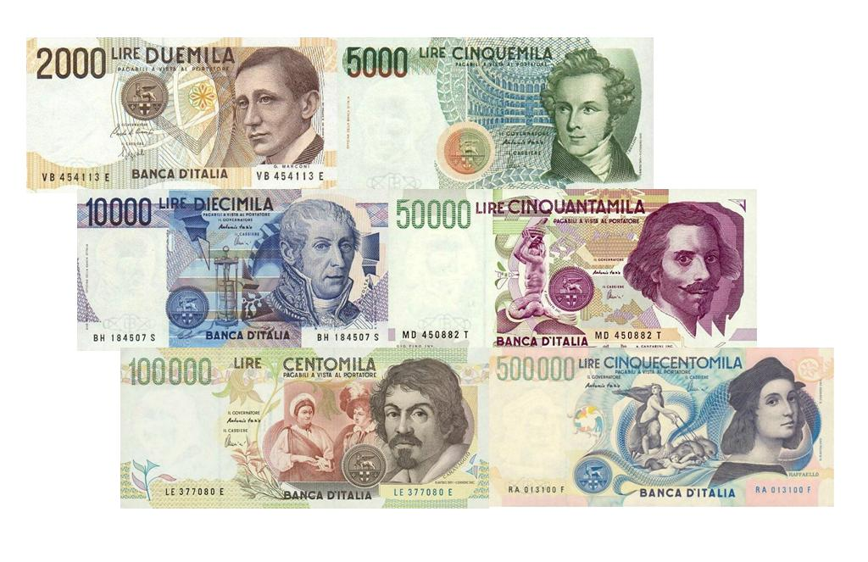
Italian Currency
Italy is part of the European central bank. They also use Euros as their country's currency.
Every Euro is equivalent to $1.10 US dollars.

Slide 4
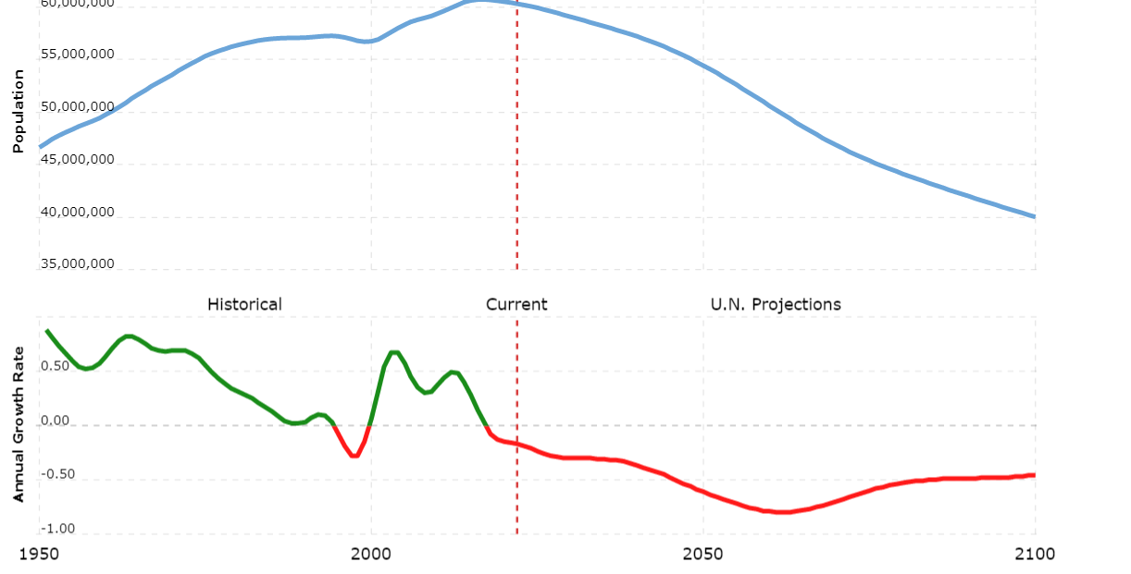
Population
Italian Population in comparison to the US
As of 2022 Italy has a population of 60,262, 770
Which is a .17% decrease in annual growth rate
Us population currently is 334,805, 269 which is an .57% increase within the year.
https://www.macrotrends.net/countries/USA/united-states/population

Slide 5
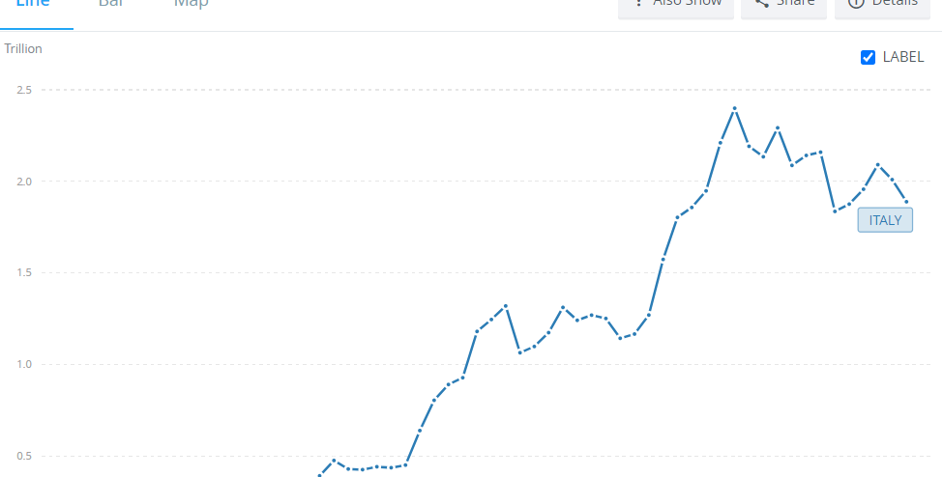
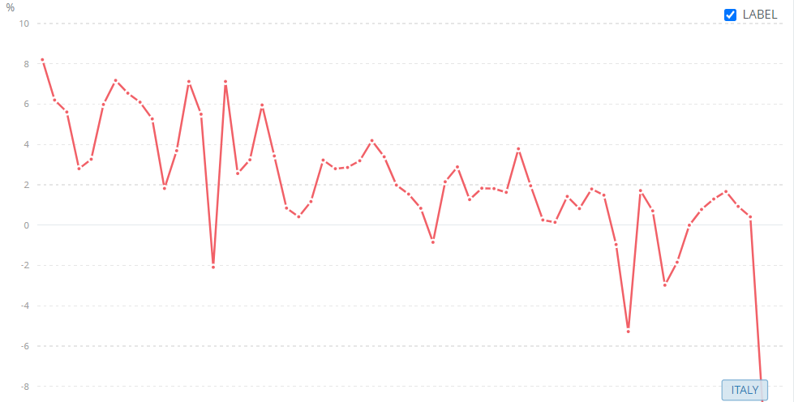
Real GDP: Italy
As of 2022 the Italian GDP was a total of 1.889 Trillion.
The GDP growth as of 2020 was a decrease of 8.939 %.
https://data.worldbank.org/indicator/NY.GDP.MKTP.CD?end=2020&locations=IT&start=1960&view=chart

Slide 6
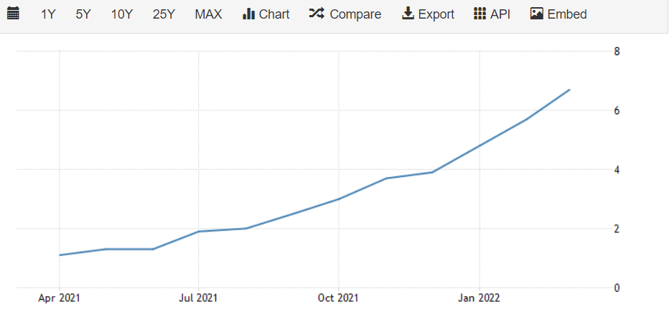
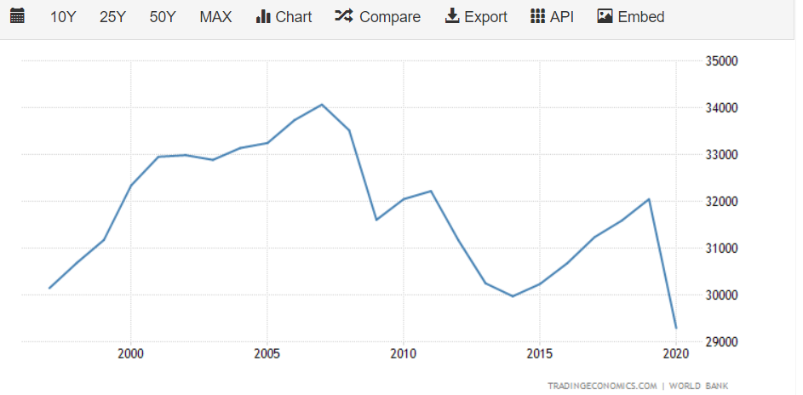
Real GDP Per Capita and inflation rate
The Real GDP per capita in Italy was a total of 32043. 91 USD.
For inflation rate we see a 6.7% increase as of march of this year. This is up from the expected 6.3% increase.
https://tradingeconomics.com/italy/gdp-per-capita

Slide 7
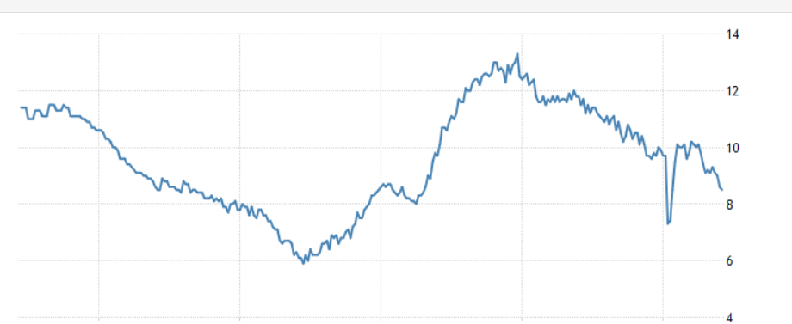
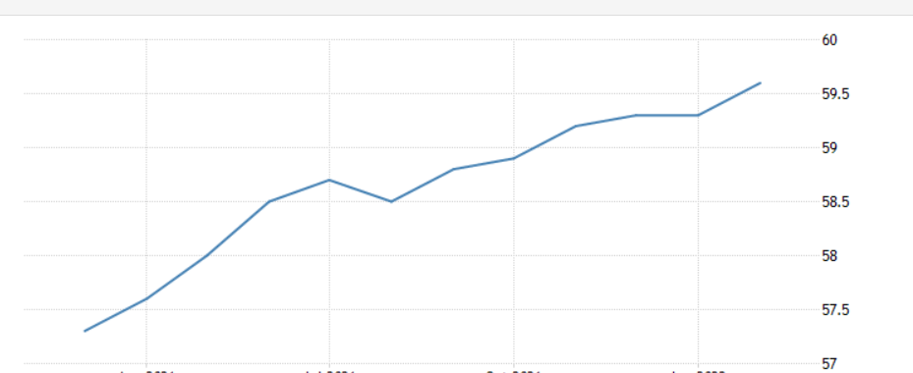
Unemployment and employment rate
The Unemployment lowered to 8.5% which was the lowest since May of 2020
Employment rate increase to 59.60%
Within this increase there were an extra 81 thousand people added to the workforce.
https://tradingeconomics.com/italy/unemployment-rate

Slide 8
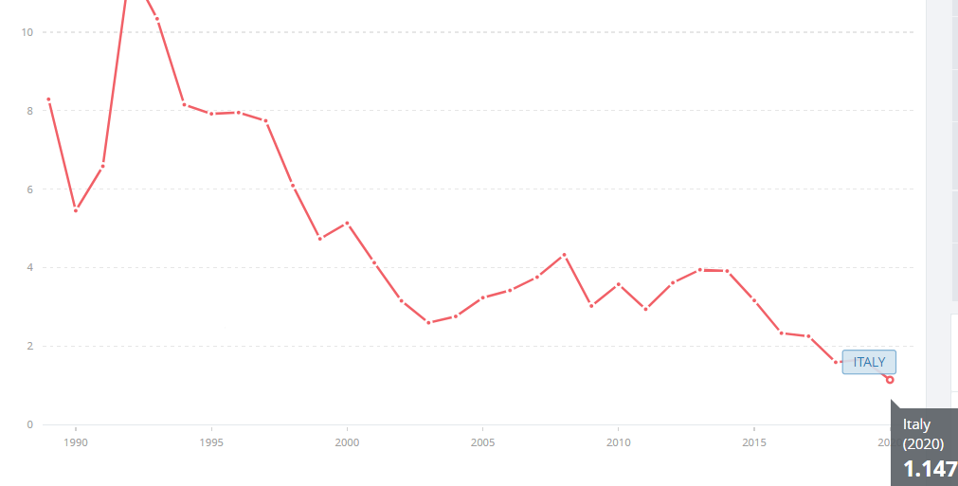
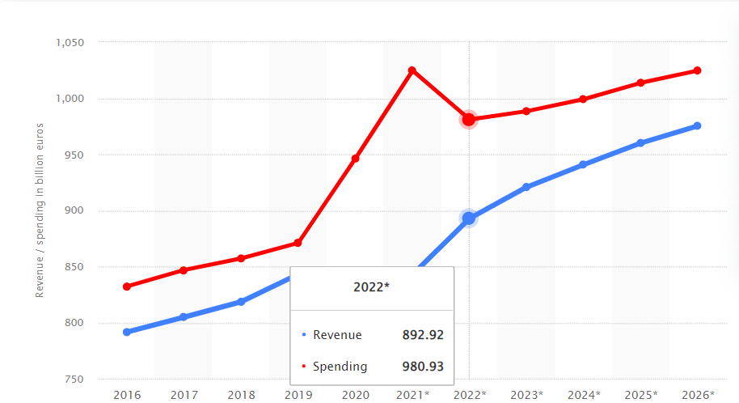
Interest Rate and Public Spending
For public spending we see there was a total of 892.92 billion euros in revenue. The total spending came out to be 980.93 billion euros.
Interest rate is controlled by the European central bank. We see that in 2020 interest rates were at 1.147%
https://www.statista.com/statistics/275319/government-revenue-and-spending-in-italy/
https://data.worldbank.org/indicator/FR.INR.RINR?locations=IT

Slide 9
Work Cited
GDP (current US$) - italy. Data. (n.d.). Retrieved April 3, 2022, from https://data.worldbank.org/indicator/NY.GDP.MKTP.CD?end=2020&locations=IT&start=1960&view=chart
GDP growth (annual %) - italy. Data. (n.d.). Retrieved April 3, 2022, from https://data.worldbank.org/indicator/NY.GDP.MKTP.KD.ZG?locations=IT
Italy GDP per CAPITA2021 data - 2022 forecast - 1960-2020 historical - chart - news. Italy GDP per capita - 2021 Data - 2022 Forecast - 1960-2020 Historical - Chart - News. (n.d.). Retrieved April 3, 2022, from https://tradingeconomics.com/italy/gdp-per-capita
Italy population growth rate 1950-2022. MacroTrends. (n.d.). Retrieved April 3, 2022, from https://www.macrotrends.net/countries/ITA/italy/population-growth-rate
O'Neill, A. (2021, November 24). Italy: Government revenue and spending 2026. Statista. Retrieved April 3, 2022, from https://www.statista.com/statistics/275319/government-revenue-and-spending-in-italy/
Real interest rate (%) - italy. Data. (n.d.). Retrieved April 3, 2022, from https://data.worldbank.org/indicator/FR.INR.RINR?locations=IT
U.S. population 1950-2022. MacroTrends. (n.d.). Retrieved April 3, 2022, from https://www.macrotrends.net/countries/USA/united-states/population

